Slide 1
CONSUMER EDUCATION
U.S. ECONOMIC SYSTEMS

Slide 2
Economics Chapter 5
Why is economics important ?
1. AFFECTS YOUR DAILY LIVES
2. HELPS YOU MAKE MORE INFORMED DECISIONS
3.MAKES YOU A MORE EFFECTIVE CITIZEN

Slide 3
Economics Chapter 5
What is economics?
Social science that examines how society uses scarce resources to produce and distribute goods and services that satisfy people’s wants and needs

Slide 4
MICROECONOMICS MACROECONOMICS
Microeconomics - is the branch of economics that examines the choices of individuals concerning one product, one firm, or one industry.
Macroeconomics - the branch of economics that examines the behavior of the whole economy at once.

Slide 5
Economic Systems
Economic system - the combination of social and individual decision making a society uses to answer the three economic questions

Slide 6
Basic Economic Problem
Scarcity-the condition that occurs because people’s wants and needs are unlimited.
Unlimited wants and needs is the human characteristics of never having all wants and needs satisfied.

Slide 7
Opportunity Costs and Benefits
Opportunity cost - value of any alternative that you must give up when you make a choice.
Opportunity benefit - what is gained by making a particular choice.
When you make an informed choice, you compare the benefit with the cost.

Slide 8
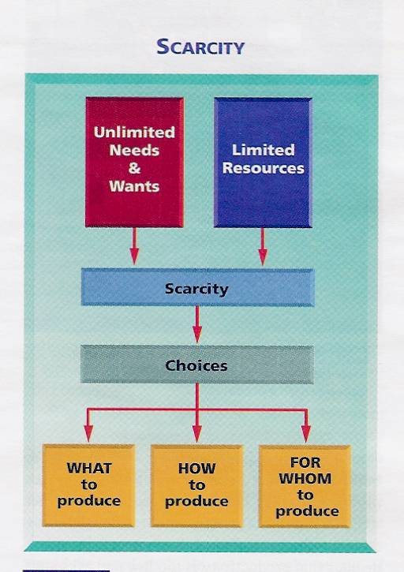

Slide 9
Economic Systems
4 Basic types of economic systems
Traditional-Traditional customs and beliefs
People hunt, fish, farm and provide shelter as their ancestors did

Slide 10
Economic Systems
Command – decisions are made by a central government
Government leaders control all economic resources
Known as-Communism

Slide 11
Market Economy -What to produce is decided by individual consumers and producers. Individuals and private companies control economic recourses
Known as Capitalism

Slide 12
Mixed - mix of command and market economic systems.
The idea of free market is combined with some degree of government control

Slide 13
Economic System Goals
1. Growth- increase the amount of goods and services produced over time
2. Efficiency-wise use of limited resources

Slide 14
3. Stability-steady level of economic well-being no extreme ups or downs
4. Justice- a system that treats all citizens fairly
5. Security-support system for citizens who face economic hardships

Slide 15
Fundamental characteristics include:
1. Private property- individuals allowed to own economic resources
2. Freedom of Choice- consumers freely choose how to spend their money

Slide 16
Freedom of Enterprise-individuals are free to own and control business enterprises
Limited government control-free to operate with a minimum of government interference

Slide 17
Factors of Production
all the economic resources necessary to produce a society’s goods and services
1. Land-natural resources and the raw materials they provide

Slide 18
2. Labor- human resources, the contributions of all workers
3. Capital- machines and technology used in the production of goods and services
4. Entrepreneurship- those willing to own their own businesses

Slide 19
Productivity- a measure of the efficiency with which goods and services can be produced
Increased by-the use of technology, education and training of the workforce

Slide 20
Business Classifications
1. proprietorships-owned or controlled by one person Estimates are that 80% of all businesses are proprietorships
2. Partnerships- a firm owned by two or more people

Slide 21
3. Corporations-an organization that is owned by many but treated by law as a single entity separate from owners
Shareholders- people who have purchased shares of stock, which are units of ownership in the company

Slide 22
Demand-is the quantity of a particular good or service that consumers are willing and able to buy at a given price
Law of Demand- Price of product goes up/Demand goes down Price falls/demand rises

Slide 23
Supply-quantity of a particular product that producers are willing and able to make available for sale.
Law of Supply-when price of a product goes up/supply goes up Price goes down/supply goes down
Why?

Slide 24
Equilibrium price-the price where consumers are willing to buy the exact quantity producers are willing to make
Labor unions-organization that represents workers for the purpose of bringing about better pay and working conditions
Do they work?

Slide 25
Collective bargaining-unions and employers negotiate an employment contract addressing issues such as pay, benefits, job security etc.
Competition-rivalry between two or more businesses, each trying to gain a larger share of the market

Slide 26
Chapter 5 Section 3
Levels of Government
1. Federal-deals with matters that affect the country as a whole
2. State-Concerned with laws within its boundary's
Local-cities and towns Try to meet the needs of its citizens

Slide 27
Government 4 roles:
1. provide public goods and services
2. regulate economic activity
3. redistribute income
4. ensure economic stability

Slide 28
Social security-an insurance program that is sponsored by the federal government and pays benefits to qualified people. Paid for by a tax on earnings
Retirement- when you reach a certain age and retire, workers who have paid Social Security taxes become eligible to receive benefits

Slide 29
Survivor’s-when insured worker dies, the surviving spouse and children (under 18) are paid benefits to replace lost income
Disability-workers who develop physical or mental conditions that prevent them from working may receive benefits

Slide 30
Medicare- program that pays some of the cost of medical and hospital care for people who are 65 and older.
Federal Assistance programs
Food stamps-unemployed, public assistance, homeless or low income may qualify to receive assistance to purchase food.

Slide 31
Regulating Economic Activity
Monopoly-a situation in which a single company controls the supply of goods or services for which there is no close substitute
Good/Bad Why

Slide 32
Antitrust laws- designed to regulate unfair business practices that reduce competition.
Examples- Mergers
Why would some mergers be looked at by the government

Slide 33
Fiscal policy-approach by government to maintain economic stability by making adjustments to policies dealing with taxing and spending
Monetary policy- involves regulating interest rates and money supply
Example- the raising or lowering of prime rate

Slide 34
Excise tax-tax on the manufacturing or sale of certain goods and services. It is included in the price paid by consumers
Examples-gas, tires, firearms, tobacco are just a few

Slide 35
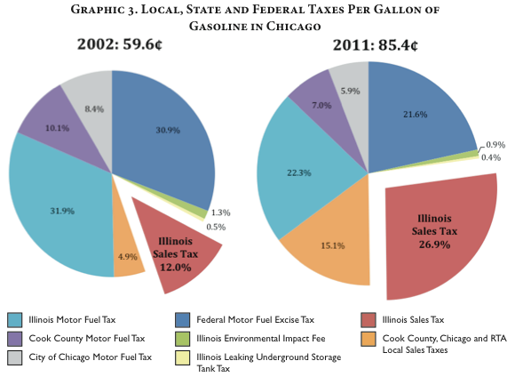

Slide 36
Estate tax- based on the value of a person’s property after his/her death, if the value exceeds a certain dollar amount, (Illinois, 2013 4 million)
Gift tax- may be charged to someone who gives a gift exceeding a certain dollar amount

Slide 37
Benefit principle-those who benefit from a public service (roads, police, fire etc) should pay for it.
Ability to pay principle- more taxes should be paid by people who can afford to pay more. Influences how tax rates are set

Slide 38
Proportional tax- takes the same percentage out of everyone's income 9% out of $25,000 0r 9% out of 100, 000
This is very much like the flat tax all the political candidates refer too.

Slide 39
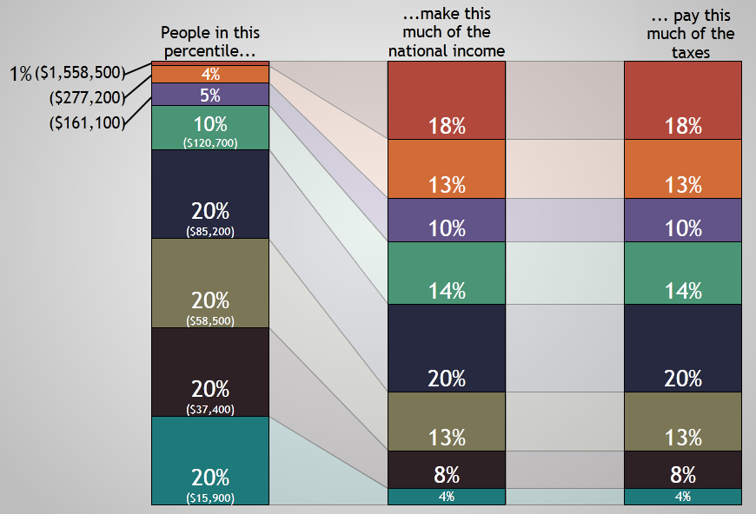
Arguments of against flat tax

Slide 40
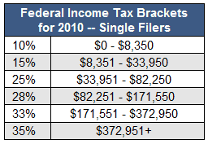
Progressive tax-takes a larger percentage of the income of high-income people than low income people. The federal income tax is progressive

Slide 41
Regressive tax-takes larger percentage of the income of low income people than high income people
Example- two families buy $8000 dollars in groceries in a year to feed their families Tax rate 5% which equals $400.00 1.6%/25,000 0.4%/100,000

Slide 42
