Slide 1
Chapter 23
Housing

Slide 2
Housing
Housing often fulfills two basic needs
1. physical need for shelter and safety
2. psychological need of privacy, belonging and family

Slide 3
Housing
Housing expenses can include:
Rent or mortgage, taxes, utilities, furniture and appliances, everyday housekeeping supplies
Other skills that might be handy:
Tools, Time, mechanical, carpentry etc.

Slide 4
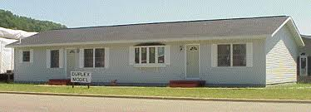
Housing
Types of Housing:
Single family-dwelling that has no shared walls and is designed to be used by one family
Duplex-contains two separate living units attached, have separate entrances

Slide 5
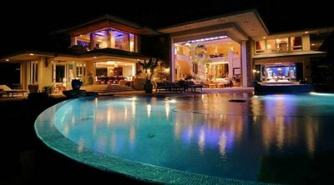
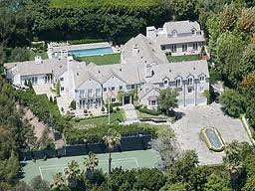
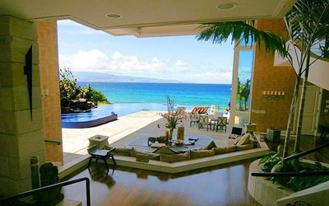
Housing

Slide 6
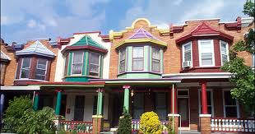
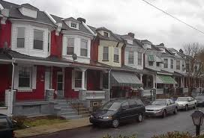
Housing
Row houses-built in a row and attached at the side walls, single families, independently owned

Slide 7
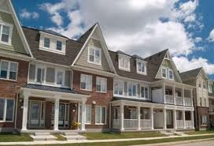
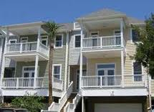
Housing
Townhouse-similar to row house, two or more stories attached by side walls May have association fees for common maintenance

Slide 8
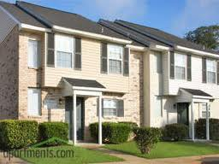
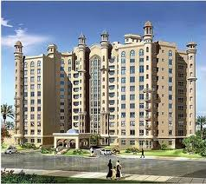
Housing
Apartment- can be divided from 2-3 units to a high rise of 100 units or more, usually one common entrance

Slide 9
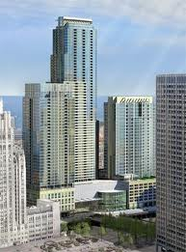
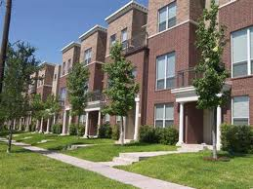
Housing
Condo- involves individual ownership and shared ownership of common areas. Owner responsible for maintaining own unit

Slide 10
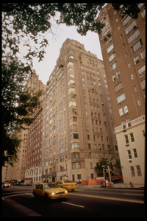
Housing
Cooperative Housing-involves ownership of shares in a corporation that owns the entire property. You have rights to a specific unit

Slide 11
Housing
Rent or buy? Depends
Renting may be easier financially starting out and may have less responsibilities than ownership
Advantages of renting:
1. Limited responsibilities

Slide 12
Housing
2. Predictable costs, no repairs or maintenance
3. Greater flexibility- pack up and go when you want
Disadvantages of renting
1. Limited Control-pets, decorating, maintaining etc.

Slide 13
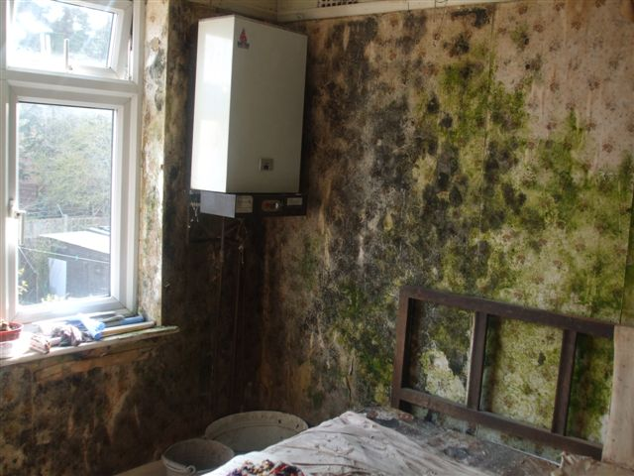
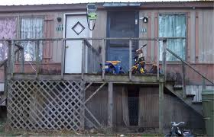
Housing
2. Financial limitations-offers no tax benefits, or building of equity
3. Fewer Conveniences-possibly shared laundry facilities, etc.
Slumlords?

Slide 14
Housing
Advantages of Buying
1. Independence-make changes as you wish, come and go as you please
2. Investment opportunities-in a healthy economy property value will grow

Slide 15
Housing
3. Tax advantages- interest paid on mortgages and local property tax are deductable
4. Feeling of security
Disadvantages of owning-
1. More maintenance- responsible for the condition inside and outside

Slide 16
Housing
2. Unplanned expense- Roofs, appliances, furnaces etc
3. Reduced flexibility-Not as easy to pack up and go. Time and expense can make it hard to do

Slide 17
Housing
Fair Housing Act- prohibits discrimination because of race, color, national origin, religion, gender, family status or disability applies to rental and privately owned property

Slide 18
Housing
Lease-legal contract that specifies the rights and responsibilities of the tenant and landlord
Security deposit-money the landlord holds until the tenant moves out as long as you do not break the lease or cause damage

Slide 19
Housing
Sublet-having another person take over the unit and pay the rent. You would still be legally responsible for the unit because your name is on the lease
Eviction- legally forcing a tenant to vacate rental property before the lease expires. Can be part of home foreclosure process also

Slide 20
Housing
Costs of buying a House:
1. Down payment 5 to 20 percent of the homes purchase price. Less than 20% could add more to your payment (PMI)
2. Closing costs-additional fees paid when the purchase is finalized
Ex. Title fee, appraisal, recording fee

Slide 21
Housing
3. Monthly loan payments
4. Continuing costs- property taxes, insurance, maintenance etc.
Remember home ownership is nice, but not for everyone

Slide 22
Housing
Types of Mortgages:
Conventional-the interest rate and monthly payment remain about the same over the length of the entire loan (higher property taxes can change payments)

Slide 23
Housing
Adjustable Rate Mortgage (ARM)-the interest changes to reflect changes in the economy usually 3-5 years
FHA- Federal Housing Administration insures loans to low and moderate income families who might not qualify for a conventional loan
VA Loan- Department of Veterans Affairs insures loans to those who have served sometimes with no down payment

